Slide 1
802.15.4 Project
The Northernites
Sam Weismuller, SangRyul “Eric” Pae, Jay Cordaro
MAS 2023 Students UC San Diego

Slide 2
802.15.4 Project RF Front End components test results

Slide 3
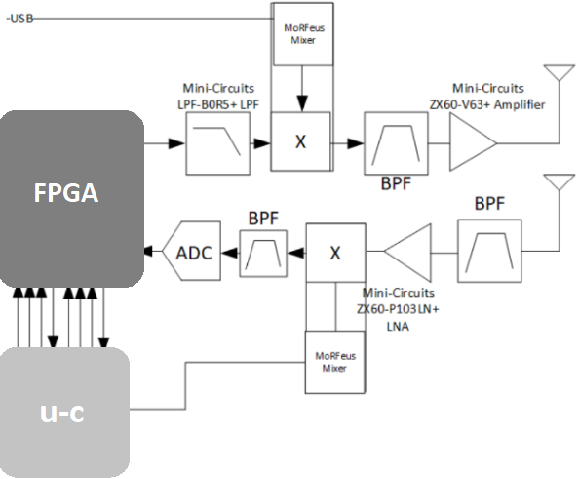
Block Diagram

Slide 4
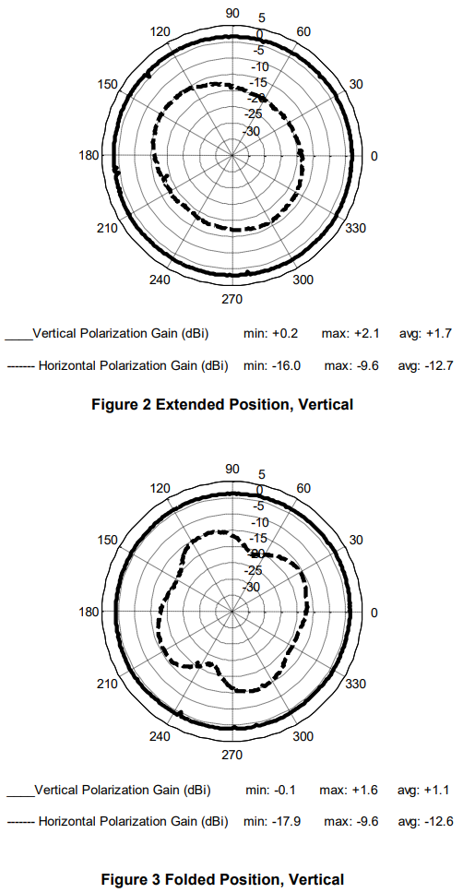
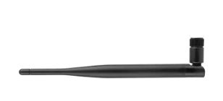
Antenna
Frequency range: 902-928 MHz (US)
Gain: typically 2-5 dBi
Polarization: linear or circular
Radiation pattern: omnidirectional or directional
Connector: typically SMA or u.FL

Slide 5
RX

Slide 6
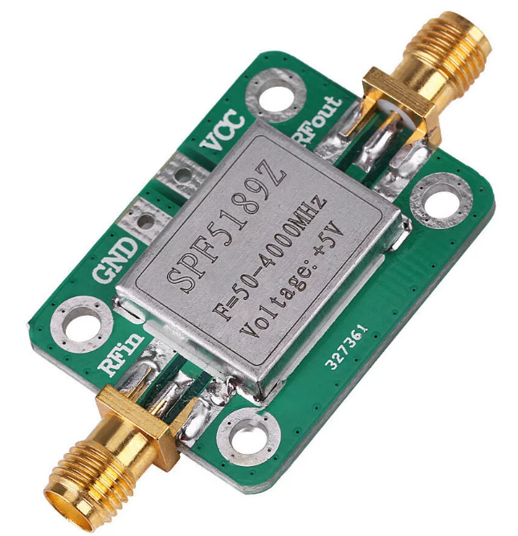
LNA
SPF5189
RF Low Noise Amplifier
Freq: 50-4000MHz
Gain : ~17dB
NF: 0.6dB

Slide 7
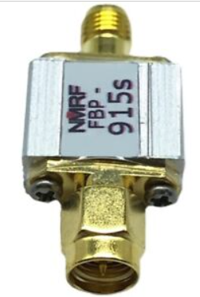
Rx RF BPF
FBP-915s
Impedance:50 ohms
Center frequency:915MHz
Passband:902～928MHz
Band Insertion Loss:<2.5 dB
Out-of-band isolation: > 40 dB @ 815 MHz and 1015 MHz
Maximum load power:300 mW (25 dBm)
Interface:SMA-M, SMA-F

Slide 8
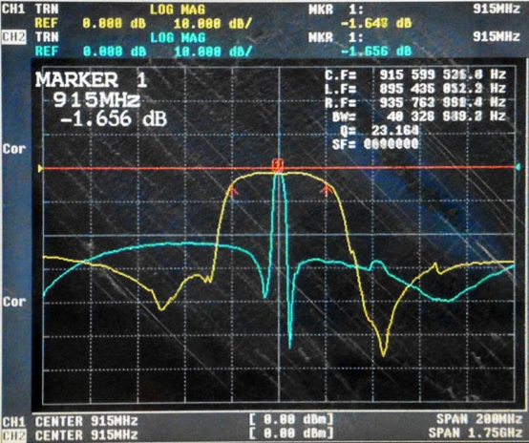
Rx RF BPF
FBP-915s
Impedance:50 ohms
Center frequency:915MHz
Passband:902～928MHz
Band Insertion Loss:<2.5 dB
Out-of-band isolation: > 40 dB @ 815 MHz and 1015 MHz
Maximum load power:300 mW (25 dBm)
Interface:SMA-M, SMA-F

Slide 9
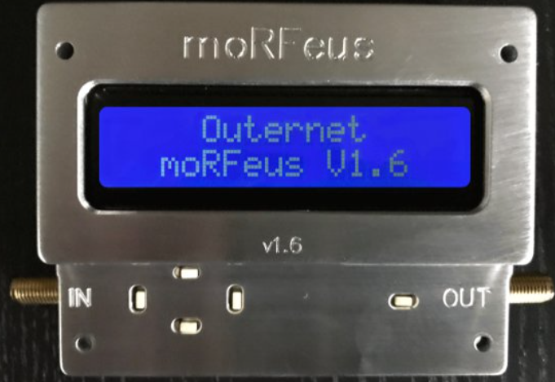
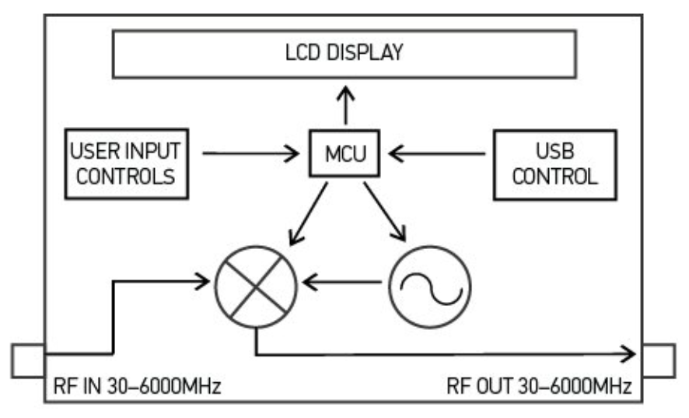
Mixer + PLL + TCXO
moRFeus
RF input frequency: 30 MHz – 6 GHz
RF output frequency: 30 MHz – 6 GHz
LO frequency: 85 MHz – 5400 MHz
Fractional-N synthesizer
LO step size: 1.5 – 3 Hz*
Up/Down conversion both are OK
(*alternative option for 2nd unit: )
( Mini-Circuits ZAD-2 mixer + SigGen with ref sync)
(* UCSD SigGen )

Slide 10
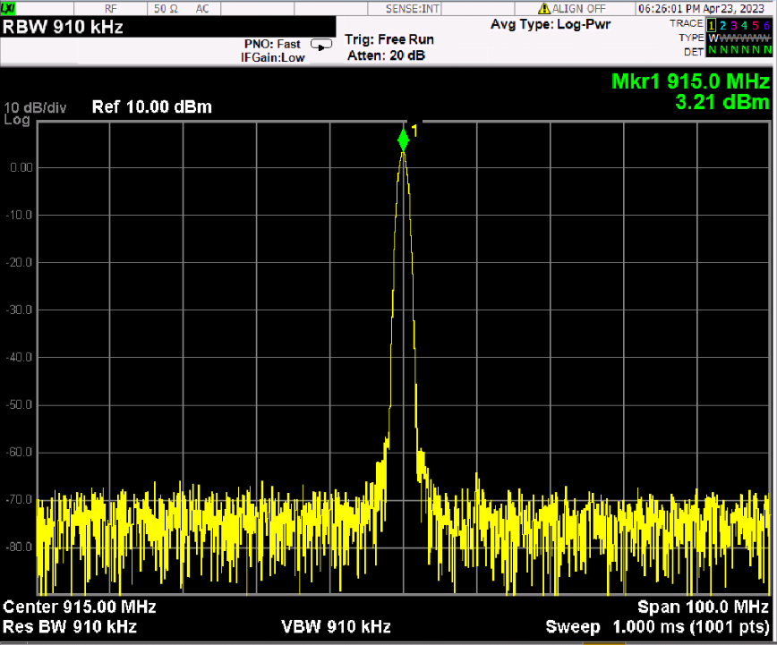
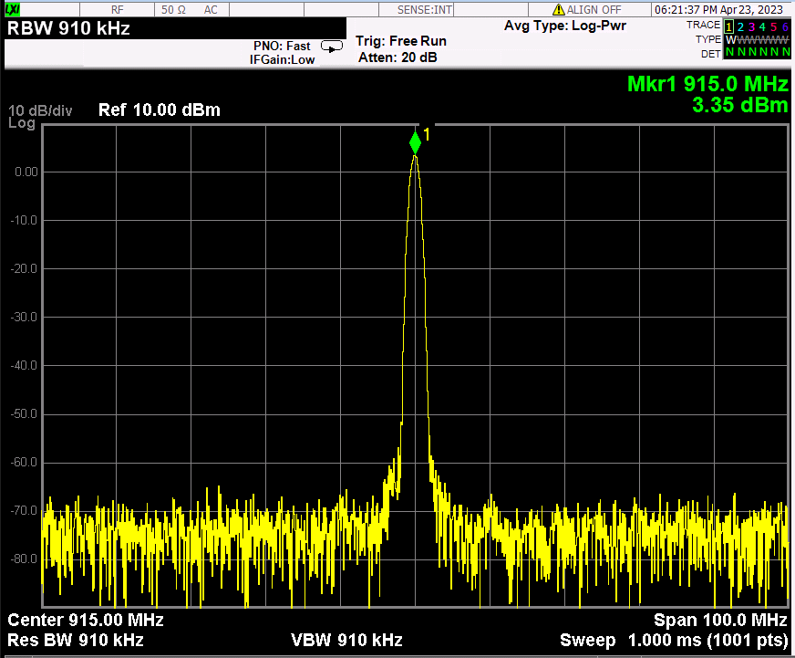
Generator mode
<moRFeus A current7>
<moRFeus B current7>

Slide 11
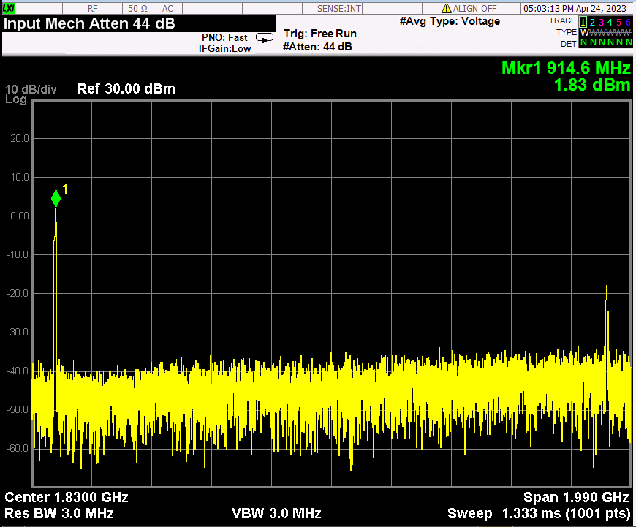
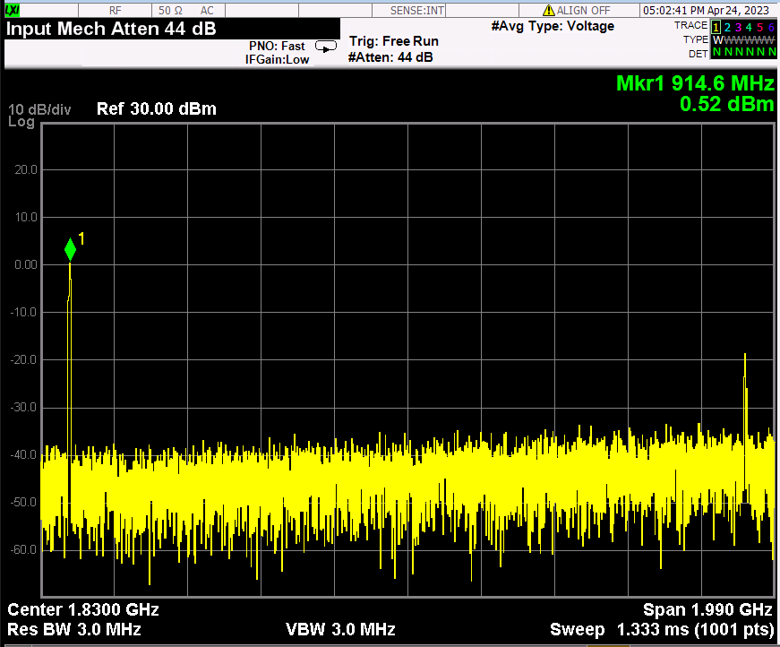
Generator mode
<moRFeus B current6>
<moRFeus B current5>

Slide 12
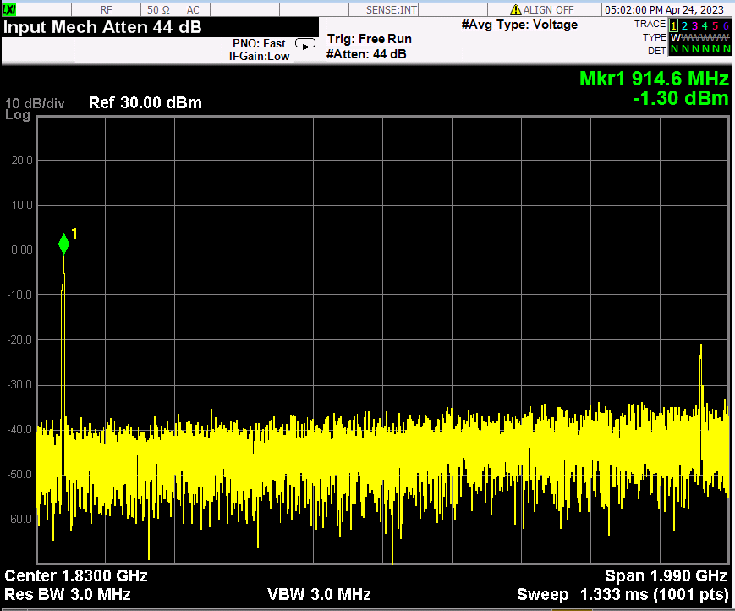
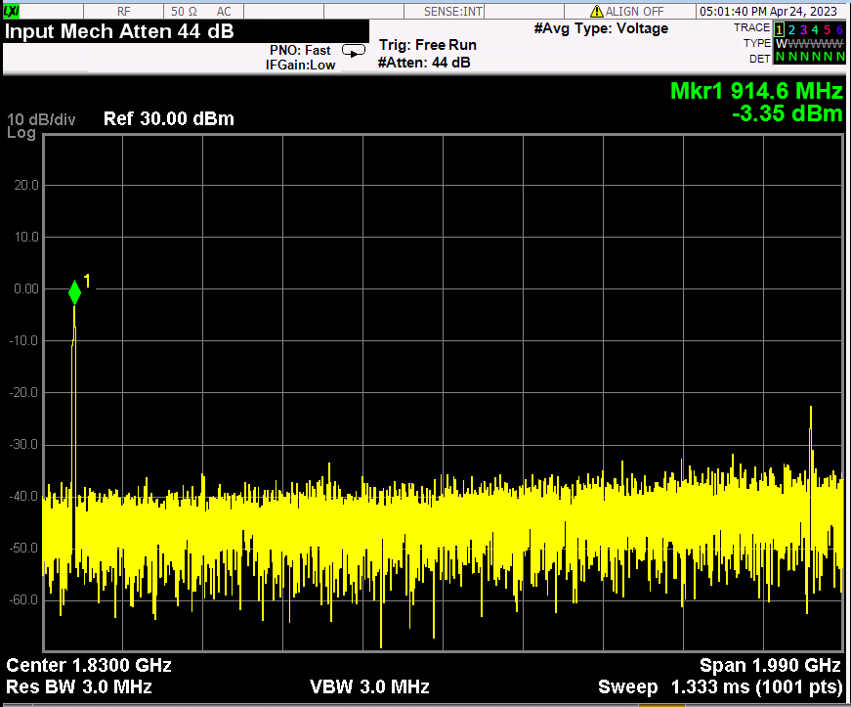
Generator mode
<moRFeus B current4>
<moRFeus B current3>

Slide 13
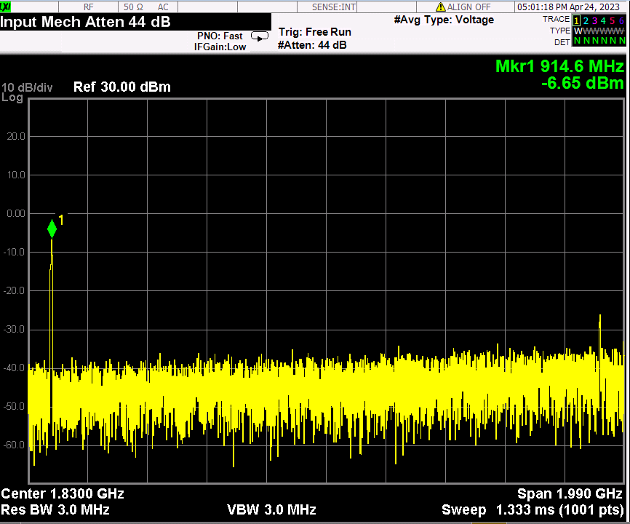
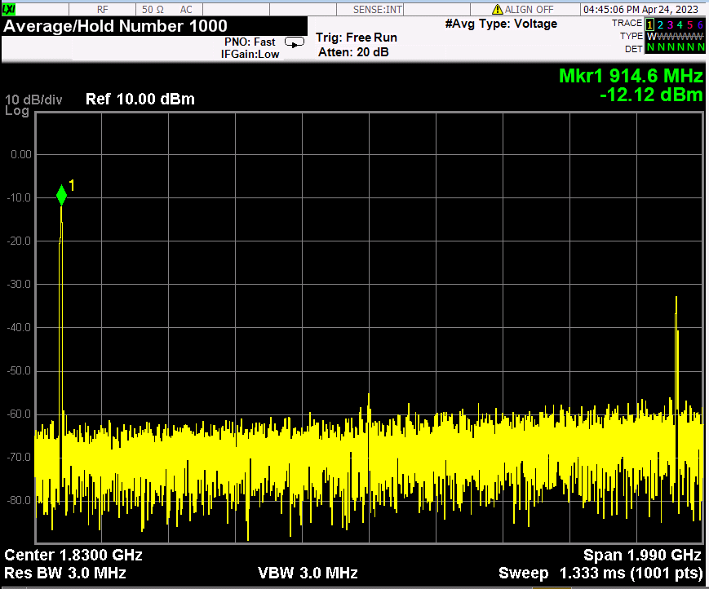
Generator mode
<moRFeus B current2>
<moRFeus B current1>

Slide 14
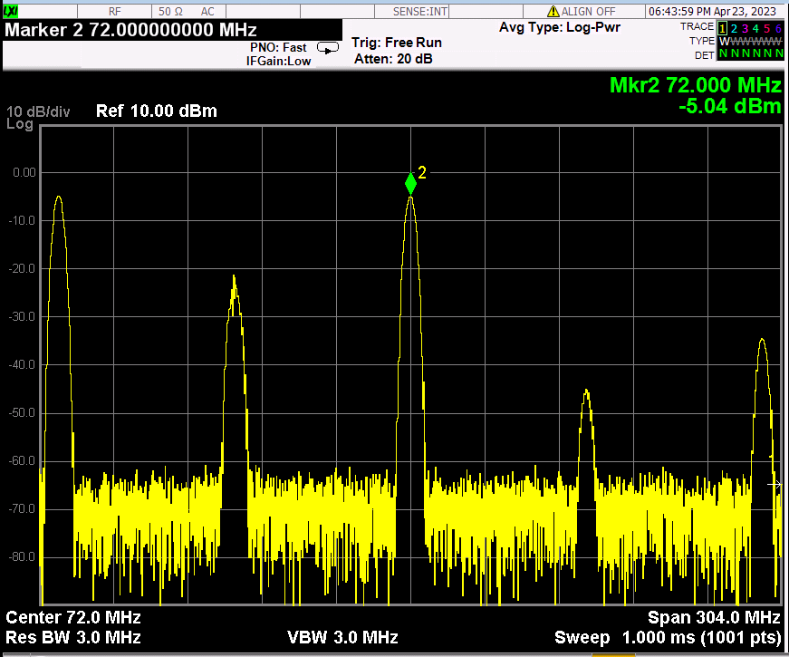
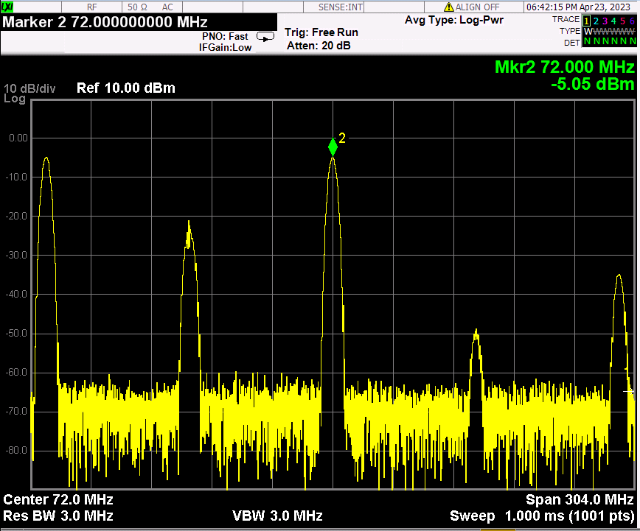
Mixer mode
morFeus B:Generator, 915MHz
morFeus A:mixer, LO:843, current:7
morFeus B:Generator, 915MHz
morFeus A:mixer, LO:987, current:7

Slide 15
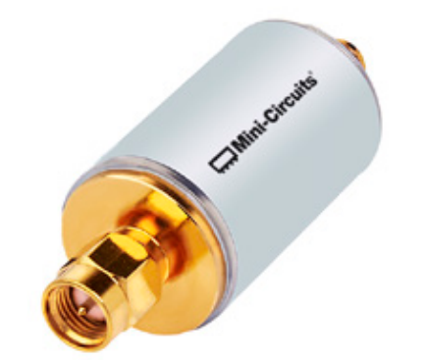
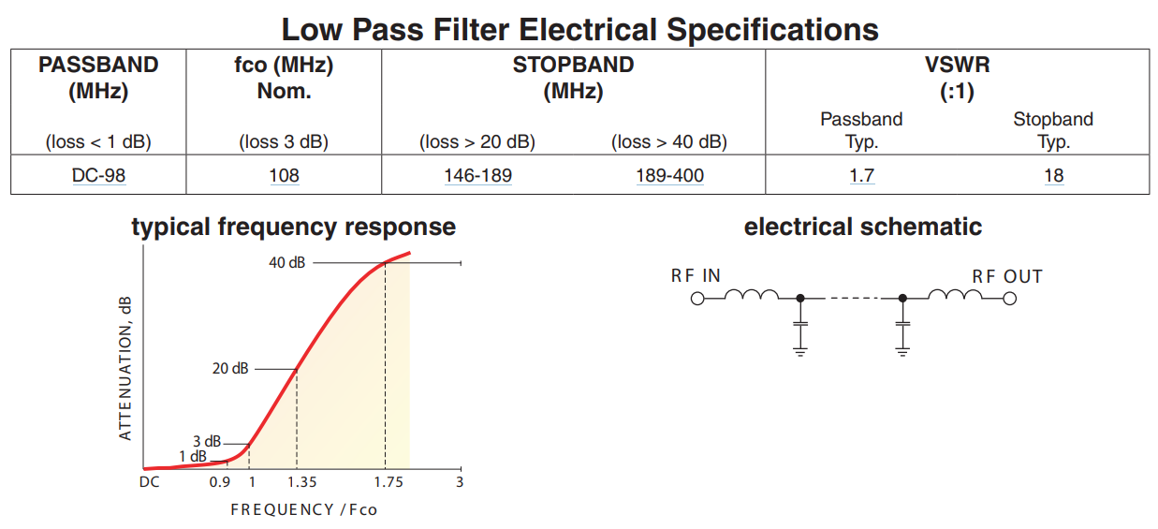
Rx IF filter
SLP100+
Pass band: DC~98MHz,
IL:0.58 @900MHz
2fo rejection : 48dB,
3fo rejection : ~75dB

Slide 16
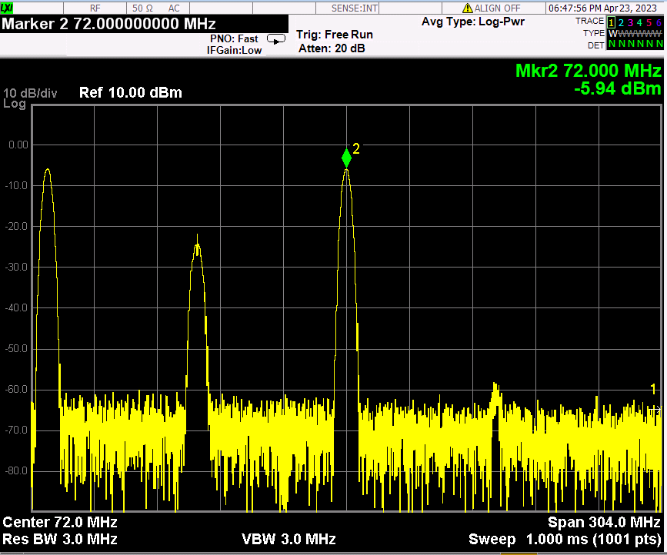
Mixer+ IF LPF(SLP100+)
morFeus B:Generator, 915MHz, morFeus A:mixer, LO:843, current:7

Slide 17
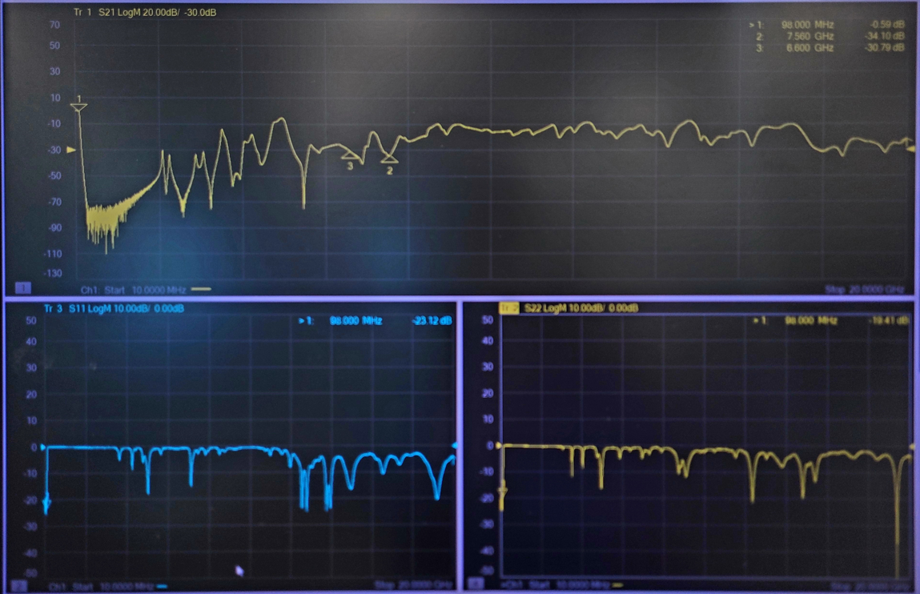
IF LPF(SLP100+) wide span

Slide 18
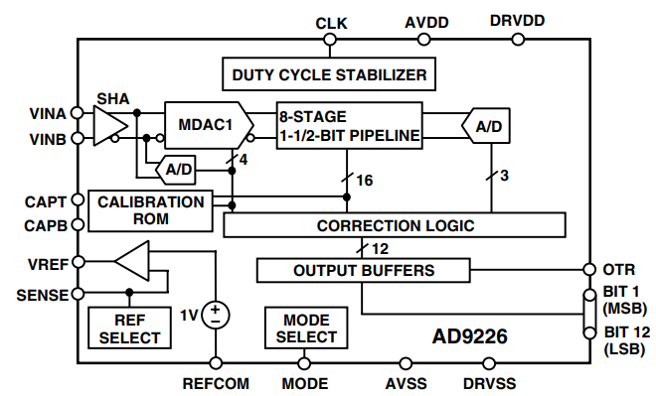
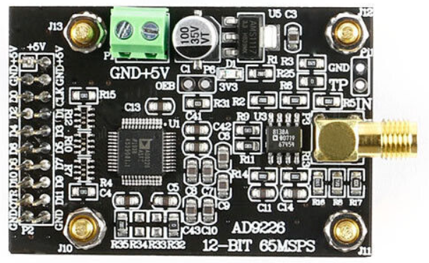
ADC
AD9226 ADC Module
Signal-to-Noise Ratio: 69 dB @ fIN = 31 MHz
Spurious-Free Dynamic Range: 85 dB @ fIN = 31 MHz
Intermodulation Distortion of –75 dBFS @ fIN = 140 MHz
ENOB = 11.1 @ fIN = 10 MHz
Low-Power Dissipation: 475 mW
Differential Nonlinearity Error: 0.6 LSB
Integral Nonlinearity Error: 0.6 LSB

Slide 19
TX

Slide 20
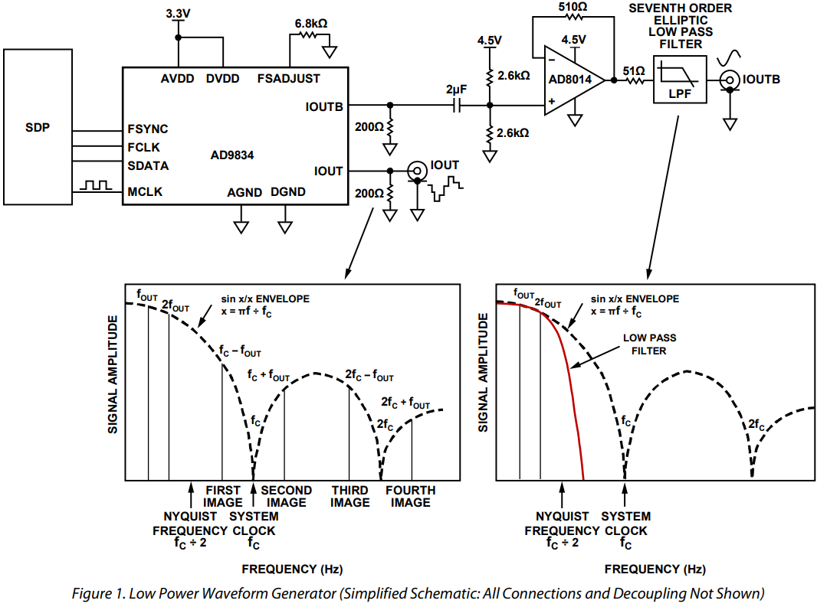
DDS

Slide 21
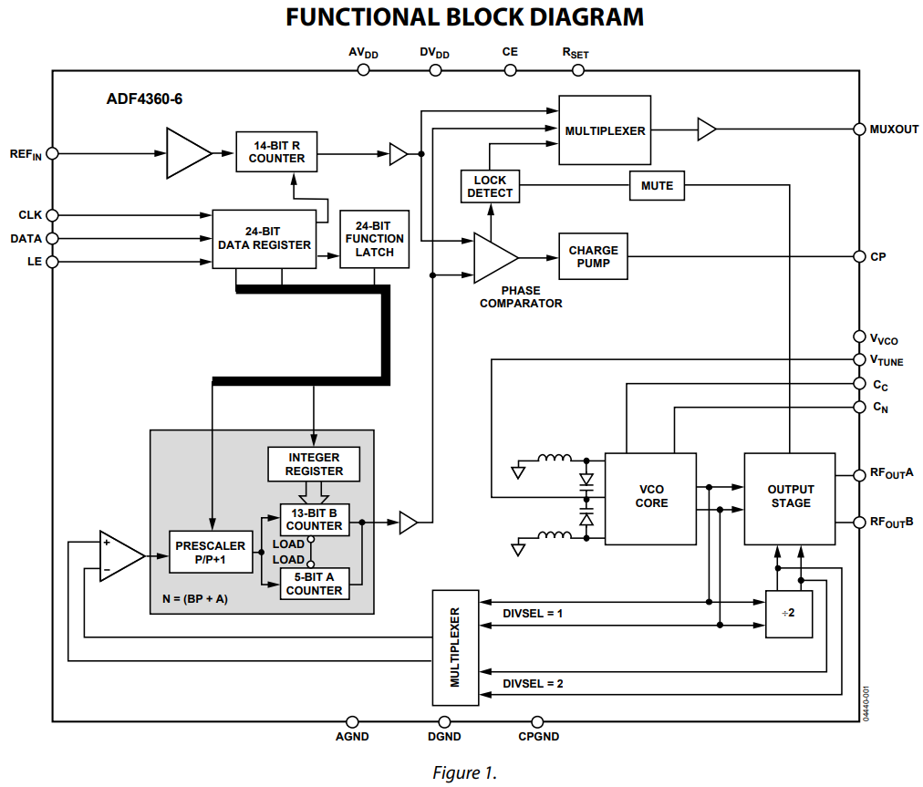
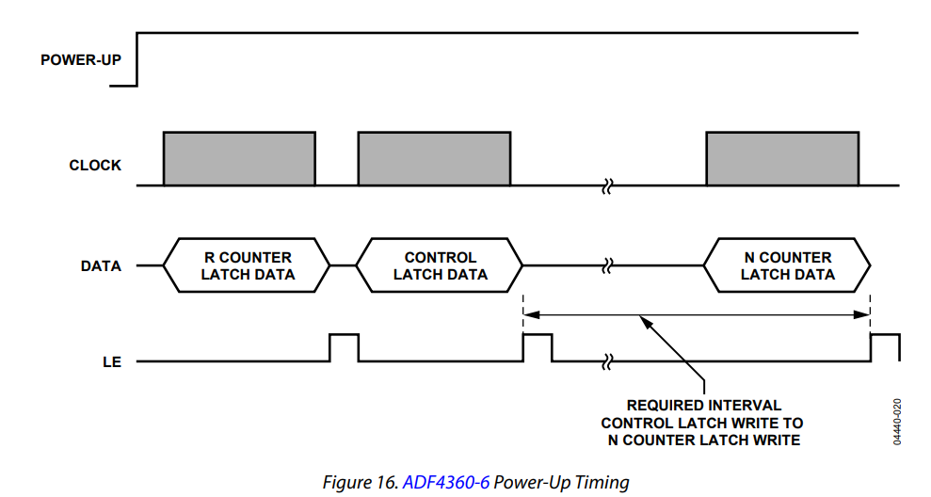
Functional Block Diagram

Slide 22
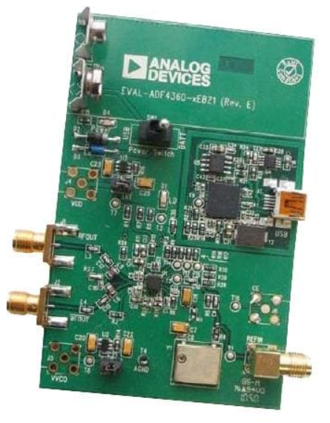
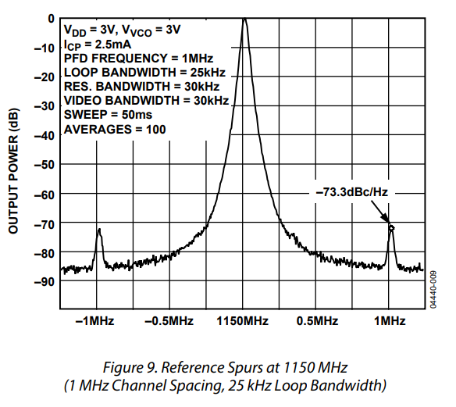
DDS
EV-ADF4360-6EB1Z

Slide 23
Mixer + PLL + TCXO
moRFeus
RF input frequency: 30 MHz – 6 GHz
RF output frequency: 30 MHz – 6 GHz
LO frequency: 85 MHz – 5400 MHz
Fractional-N synthesizer
LO step size: 1.5 – 3 Hz*
Up/Down conversion both are OK
(*alternative option for 2nd unit: )
( Mini-Circuits ZAD-2 mixer + SigGen with ref sync)
(* UCSD SigGen )

Slide 24
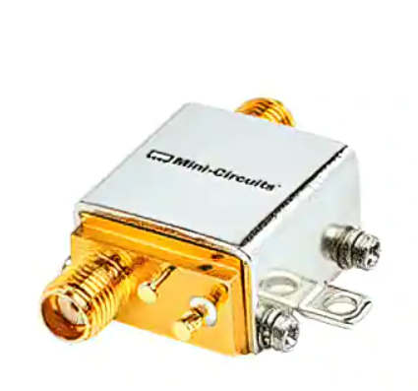
PA
ZX60-V63+
Frequency: 50MHz ~ 6GHz
P1dB : 18.5dBm
Gain : 15.4dB
Noise Figure : 4.3dB
Voltage - Supply : 4.8V ~ 5.2V
Current - Supply : 69mA
SMA Connectors

Slide 25
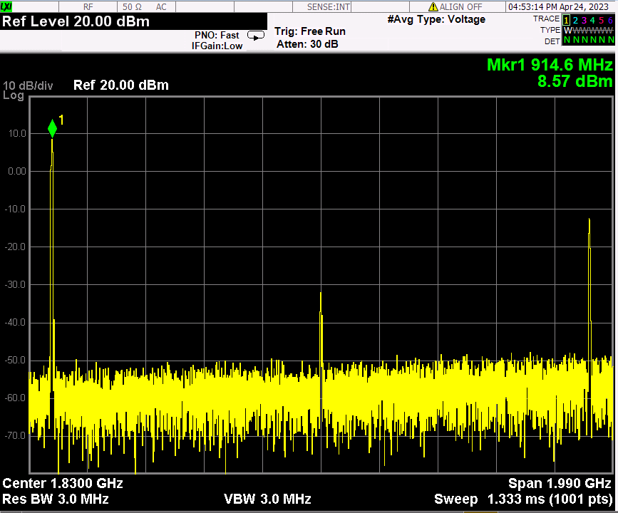
moRFeus generator(-12.12dBm)+ PA(ZX60-V63+)

Slide 26
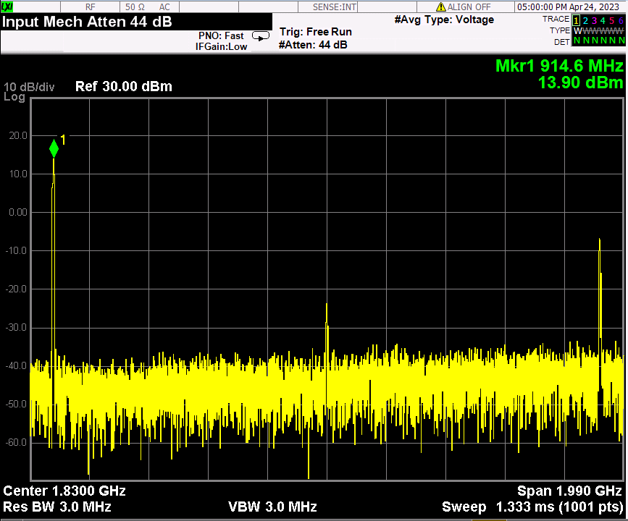
moRFeus generator(-6.65dBm)+ PA(ZX60-V63+)

Slide 27
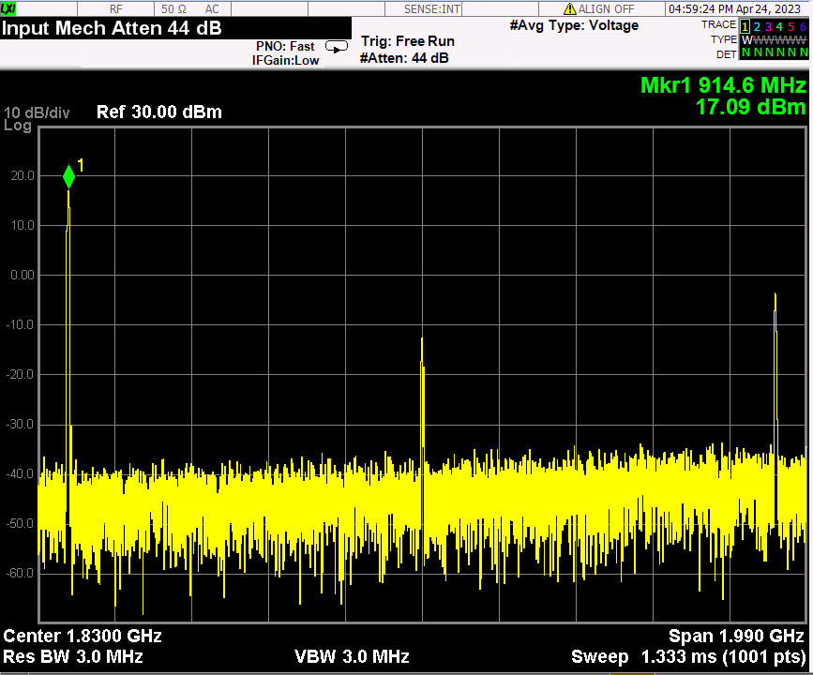
moRFeus generator(-3.35dBm)+ PA(ZX60-V63+)

Slide 28
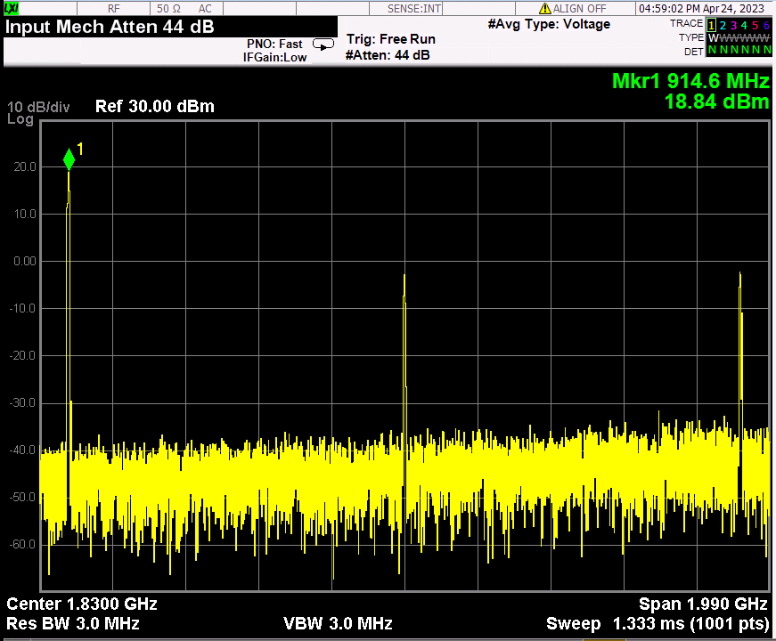
moRFeus generator(-1.30dBm)+ PA(ZX60-V63+)

Slide 29
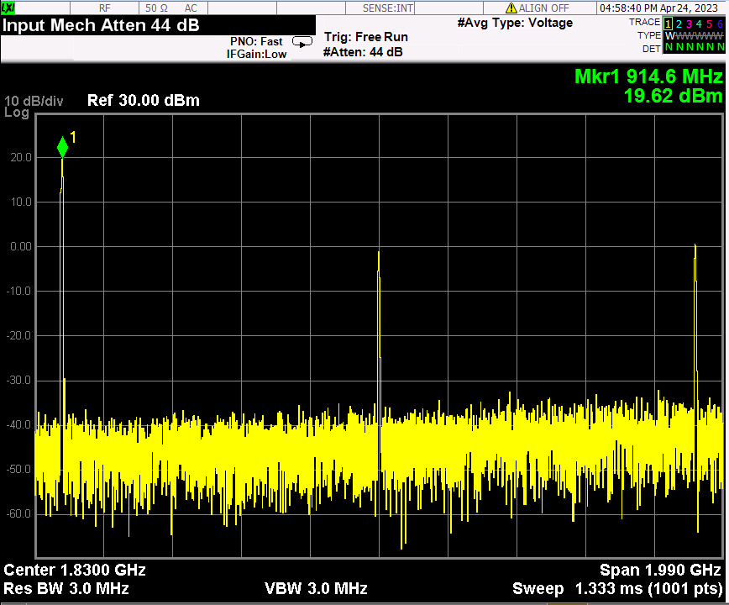
moRFeus generator(0.52dBm)+ PA(ZX60-V63+)

Slide 30
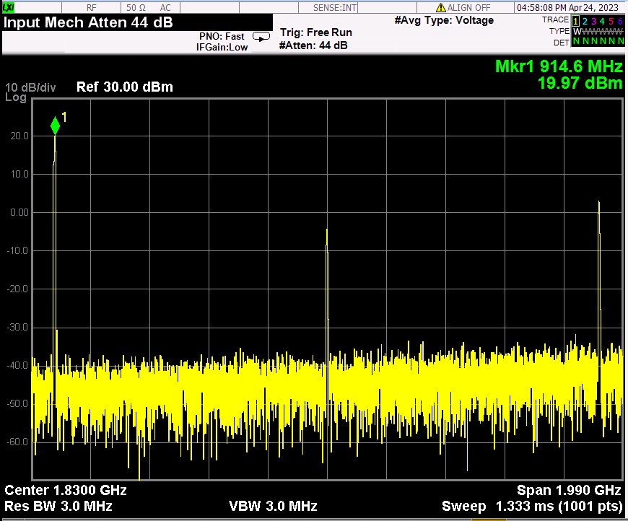
moRFeus generator(1.83dBm)+ PA(ZX60-V63+)

Slide 31
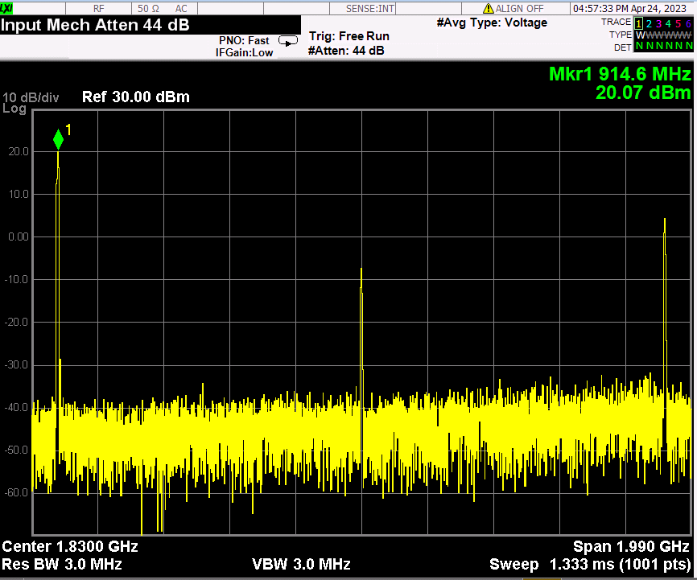
moRFeus generator(3.00dBm)+ PA(ZX60-V63+)

Slide 32
RF Frontend + Mixed signal parts list

Slide 33
Future work
Link budget analysis : range vs. BER
RF Frontend + chanel model with Simulink for timing recovery simulation of baseband.
Rx/Tx chain integration and performance test.
Mixed signal part & FPGA interoperability test.
Troubleshooting for whole system operation.

Slide 34
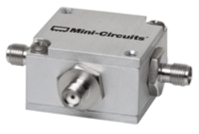
Mixer(ZFM-4H-S+): back up component
ZFM-4H-S+
low conversion loss, 4.97 dB typ.
good L-R isolation, 35 dB typ, L-I, 35 dB typ.
wideband, 5 to 1200 MHz
rugged shielded case

Slide 35
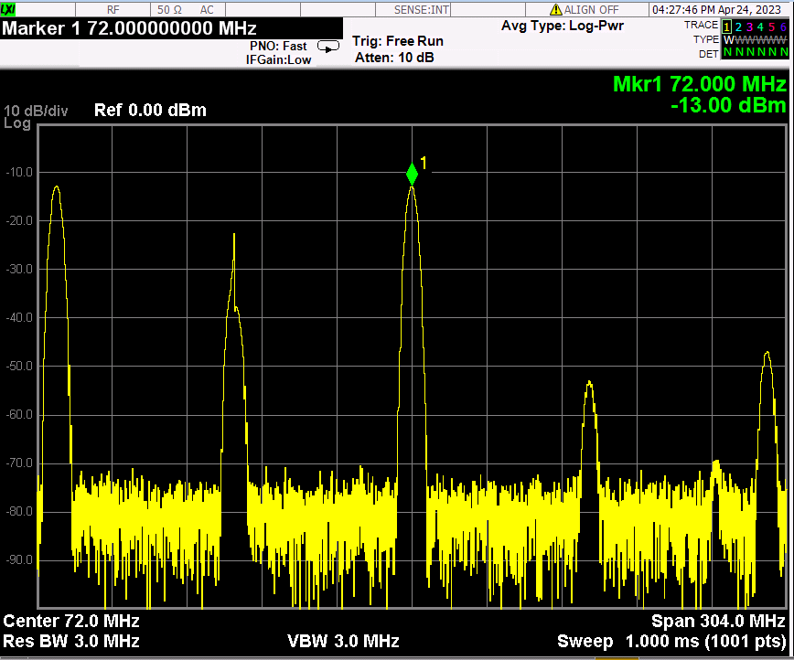
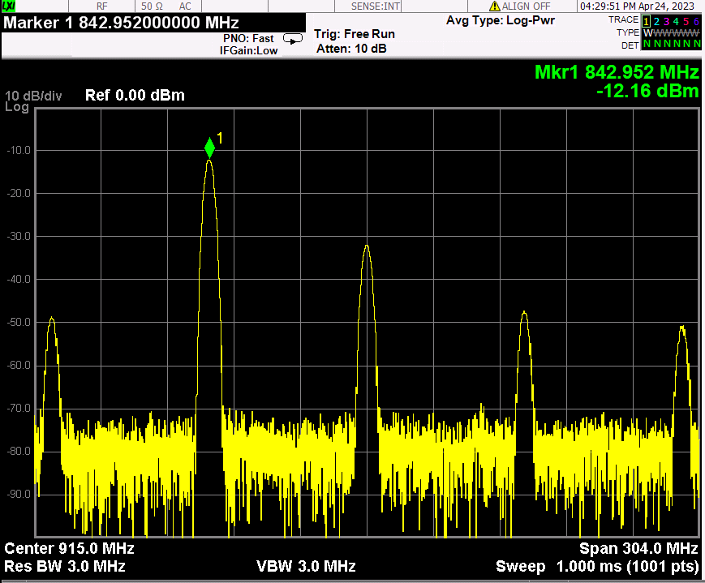
ZFM-4H-S+_I:843MHz(3dBm), L:915MHz(3dBm), R: out

Slide 36
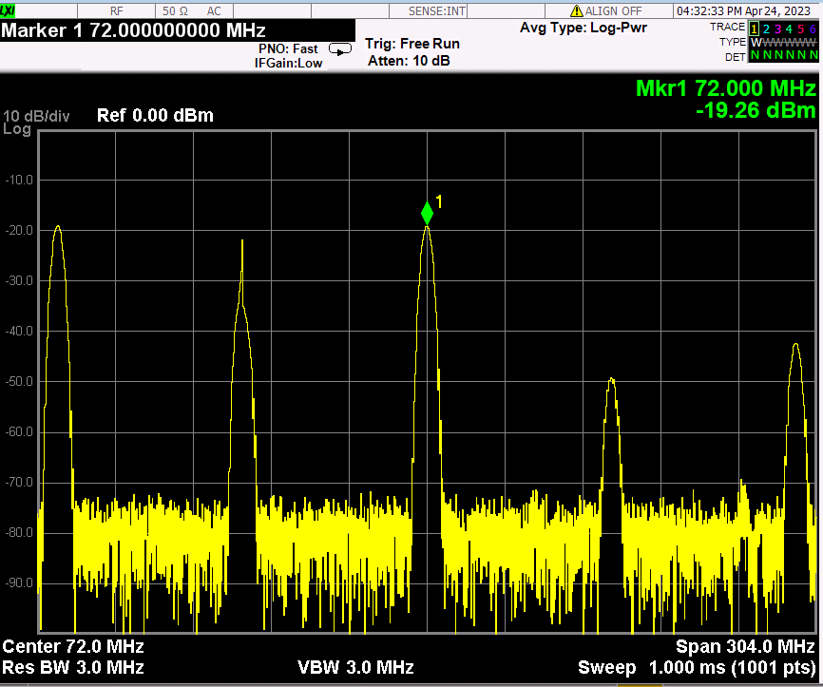
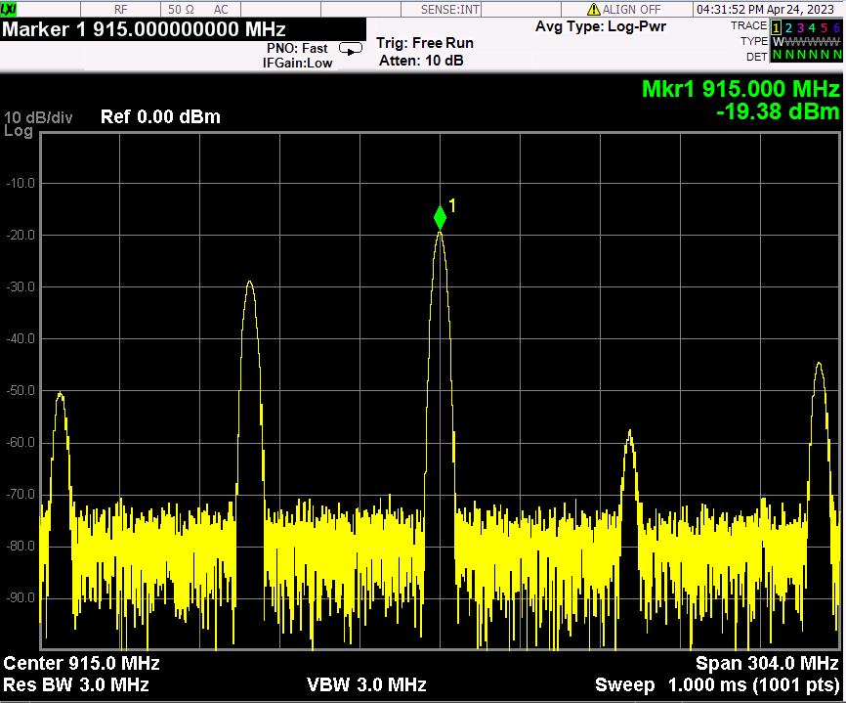
ZFM-4H-S+_I:915MHz(3dBm), L:843MHz(3dBm), R: out

Slide 37
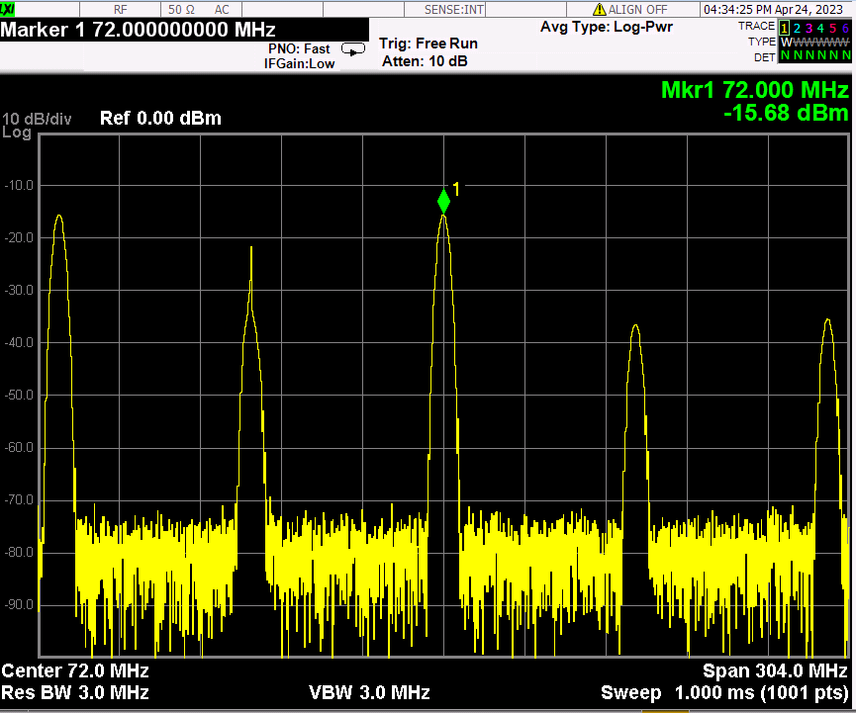
ZFM-4H-S+_I:915MHz(3dBm), L:out, R: 843MHz(3dBm)

Slide 38
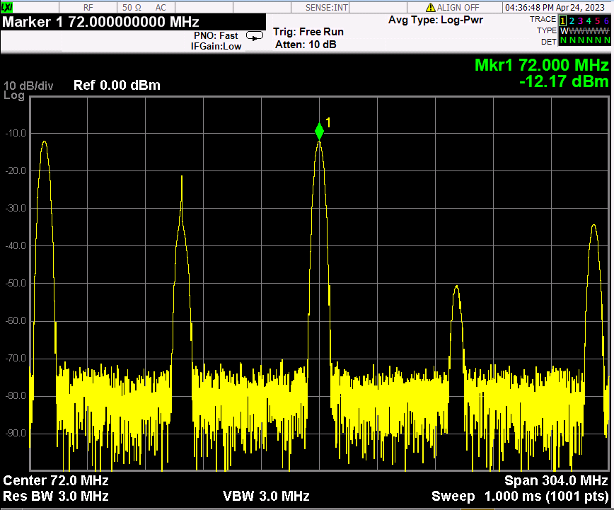
ZFM-4H-S+_I:out, L:915MHz(3dBm), R: 843MHz(3dBm)

